Slide 1

Sprint 1 – Personal project
Casey Stijlaart

Slide 2

Table of Contents
Sprint 1 Goals
Git
Project Plan
Algorithms
Database
Sprint 2 Goals

Slide 3

Sprint 1 Goals
Project Plan
US : Data Storage
US : Containered Database
US : Musical Algorithms

Slide 4
Project Plan
Project Goal
The goal is to successfully design and implement an embedded system that effectively utilizes environmental data to create musical compositions via algorithmic processes. The musical composition should clearly indicate the environmental status to humans. Allowing for data to be informative in a non-text-based manner.

Slide 5

Algorithms
Existing
Composition
Sonification
Data-driven soundscapes

Slide 6
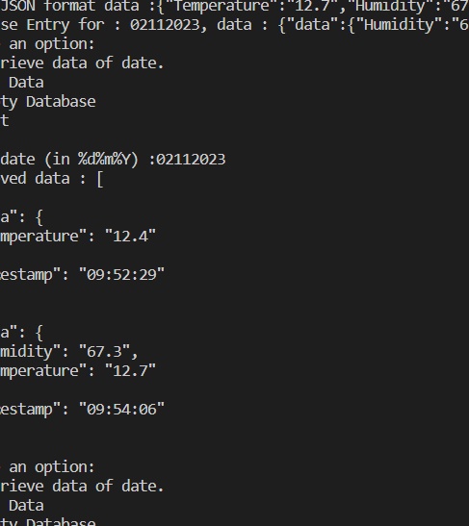
Database
Containered through Docker
Interaction of database
Add Data
Retrieve Data
Remove Collection
Manual Testing Demo
Existing Issue
Unable to Interact with Cloud Database in Docker Application

Slide 7

Sprint 2 Goals
User Story : Data Storage
Cloud Database Configuration
User Story : Sensor Data Capturing

Slide 8
Questions and Feedback?

